Slide 1
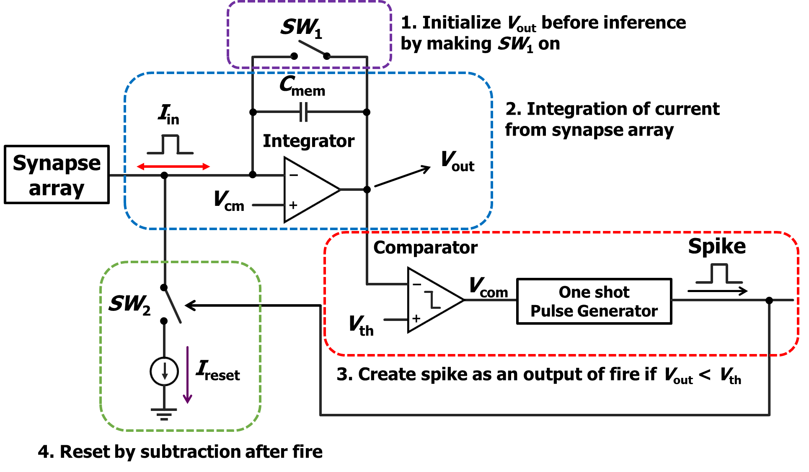
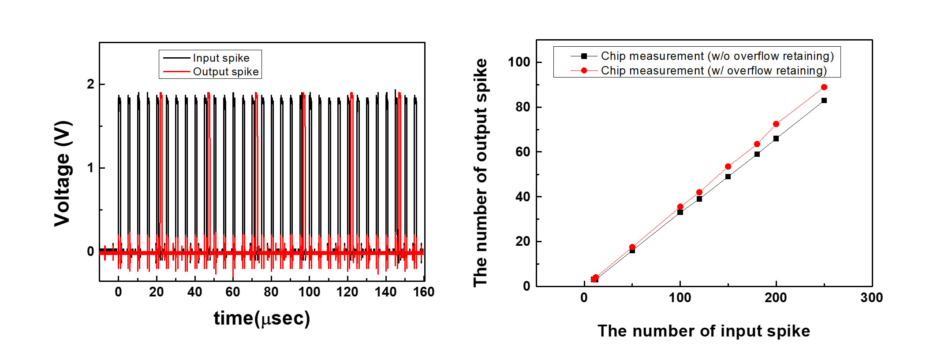
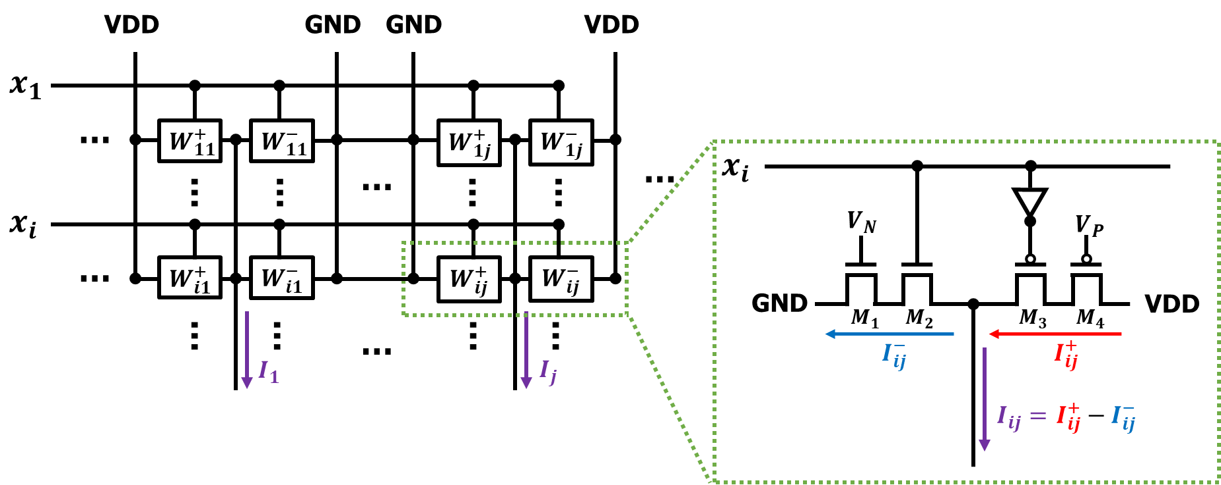
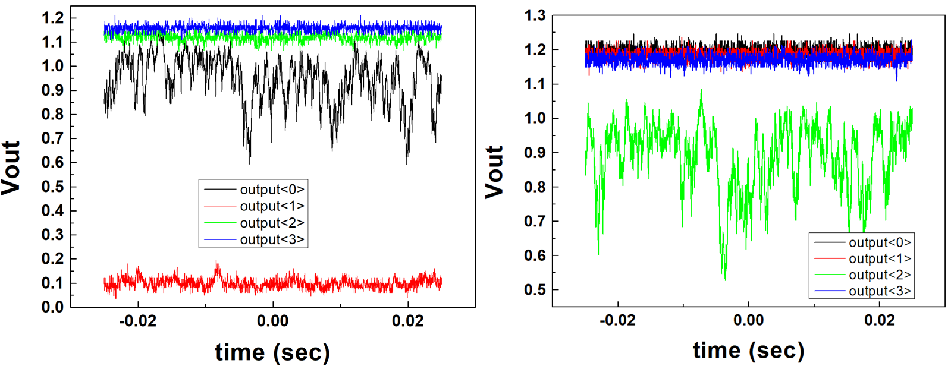
Integrate and Fire neuron circuit
Jaesung Kim¹, Minsuk Koo², Yoon Kim^{1*}
School of Electrical and Computer engineering, University of Seoul¹, Dept. of Computer Science and Engineering, Incheon National University²
Introduction
In this paper, to realize SNN system known as efficient artificial neural network(ANN) in hardware, we designed and measured a integrate and fire(I&F) neuron circuit and a synapse with a 28 nm CMOS technology. The I&F neuron circuit can retain overflow and allow underflow to catch up with the performance of ANN implemented in software. We conducted a simulation using MATLAB to investigate the performance improvement of the SNN system by overflow retaining and underflow allowing. Our findings showed that the overflow retaining and underflow allowing techniques were effective in enhancing the SNN’s performance.
Main contents
<I&F neuron circuit’s schematic>
< Measurement result of prior work>
Overflow retaining and underflow allowing function to improve SNN system’s performance
The designed I&F neuron circuit’s energy per spike was 31.56 pJ/spike on simulation and area is 4231.88 um².
Prior work’s I&F neuron circuit’s measurement result was what we expected.
<Synapse array schematic>
<Measurement result of this work>
Synapses consist of excitatory parts and inhibitory parts for neuron circuit’ work
This work’s I&F neuron circuit didn’t work as we expected
Result and Discussion
As the prior work’s chip worked as we expected, in this work, we were going to advance the I&F neuron circuit more than prior work. Because prior work’s chip was designed by 180nm technology, we were going to make the I&F neuron circuit more power efficient and reduce the area per neuron circuit. Also, we changed the I&F neuron circuit’s design a little bit to improve linearity. But, the fabricated chip didn’t work as we expected. Specifically, the chip’s output signals were not initialized to initial voltage or controlled by our command signal. We had confirmed that the command signals generated by the FPGA was being properly applied. So, we concluded that there were some mistakes like misconnected metals, shorted metal lines or shortage of repeater’s power. Because there is no other port that we could analyze internals of the chip except for the I&F neuron circuit’s output node, we couldn’t analyze accurately what the problem is. To prevent these mistakes, next time, we would spend more time to demonstrate the circuit. For example, we will stabilize power and ground supplied to the chip and simulate corner simulation, monte-carlo simulation, post-layout simulation to check unexpected parasitic capacitance or make some ports for internal node we can probe.
Acknowledgement
This research was supported by National R&D Program through the National Research Foundation of Korea(NRF) funded by Ministry of Science and ICT(2021M3F3A2A01037928), The chip fabrication and EDA tool was supported by the IC Design Education Center(IDEC), Korea.

